Slide 1
Identifying Problem Events in Operational Data
Ryan Metcalf
Sr. Information Management Consultant
Daugherty Business Solutions

Slide 2
Acknowledgments
Brian Chelsey - Daugherty
Josh Ulrich - RUG (and BFF!)
Adam Doyle - Daugherty
Julia Dihn - Daugherty
Ryan McNeely - Daugherty
Josh Peck - Daugherty
David O’Brien - RUG
Carl McQueen - RUG
Jim Horn - RUG
"If I have seen further than others, it is by standing upon the shoulders of giants." - Isaac Newton

Slide 3

Business Problem
Identification of the next likely event based on a previous sequence.
Sequence Identification examples:
Sequence of events that lead to a sale.
Identifying if a machine is about to have a fatal event.
Medical readings to indicate if a patient is getting sicker.
Identifying possible churn in a customer account.
Notes:
Identification of the next likely event based on a known sequence of preceding events. Useful for anticipating a likely outcome.
Speak to context of each example

Slide 4
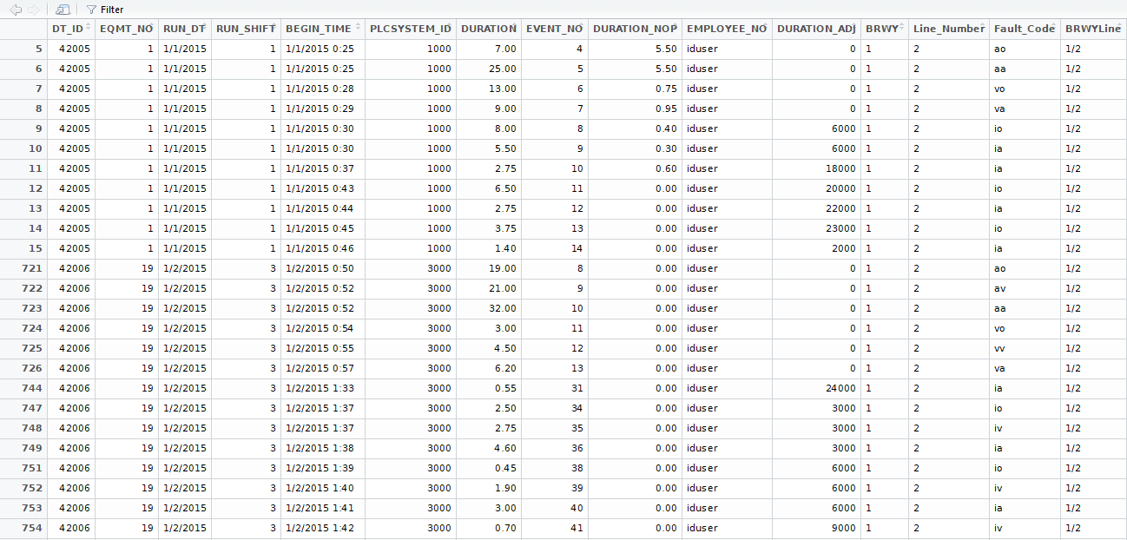
What The Data Looks Like

Slide 5
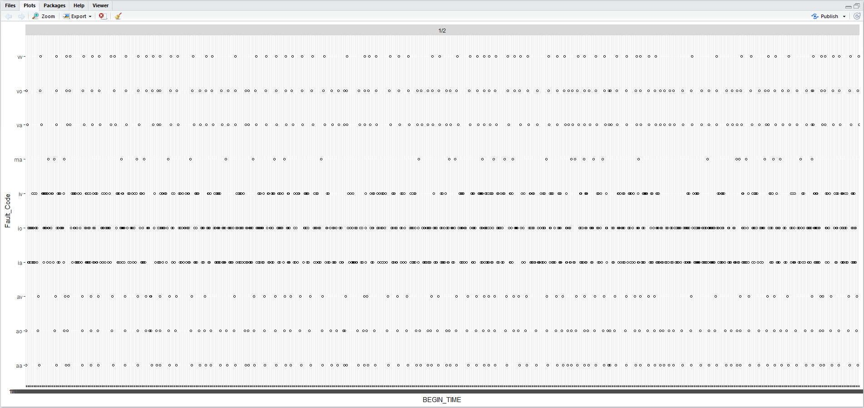
What The Data Looks Like

Slide 6
Data Speed Dating
No Data Dictionary
No Operational Information
Assumptions
Oops

Slide 7
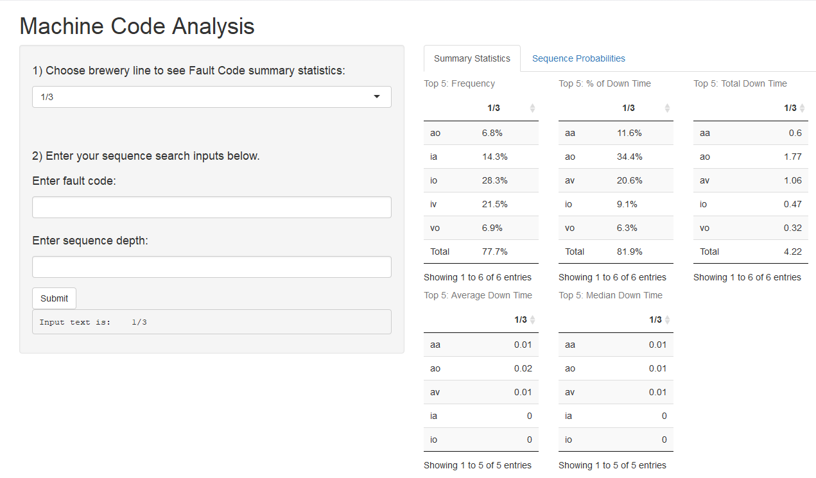
Solution
An interactive app which allows users to search for an event of interest.

Slide 8
Search Algorithm
Find all sequences
Create lag columns in data set
Find what those sequences lead to
Calculate the probability of the Fault Code
Visualize
Notes:
Concisely describe the 2 step search, why it’s important.

Slide 9
Key R Functions
which() function in Base R
The which() function will return the position of the elements (i.e., row number/column number/array index) in a logical vector which are TRUE.
What is the position of alphabet 'z' in a-z letters. which(letters=="z") It returns 26 as 'z' is positioned at 26th place.
lag.xts() function in the xts package
Creates a lagged series from data by shifting series k periods.

Slide 10
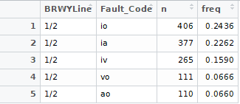
Analytics
Subset data
Calculate fault code metric
Find the top 5
Swing table to crosstab
Separately, calculate total and append
Formatting

Slide 11
User Experience
Guide the user. Get them thinking and asking questions.
Delineate that the app provides two functions.
Keep it clean and functional.

Slide 12
Shiny Challenges
Submit button
actionButton("Submit", label = "Submit")
Summary Stats layout
fluidRow(column(2,dataTableOutput("freqTopCount"))
DataTable options
DT::renderDataTable({}, options = list(), rownames = TRUE, caption = "Top 5: Median Down Time")

Slide 13
Shiny Challenges
Sequence Probabilities output
output$probabilities <- DT::renderDataTable({
probs <- DT::datatable(values$probabilities, rownames = FALSE,
caption = paste("Probability the Sequence will lead to Fault Code",
input$faultCode),
options = list(paging = FALSE, searching = FALSE,
columnDefs = list(list(className = 'dt-right',
targets = 2,
type = "num-fmt"))))
DT::formatPercentage(probs, "stats.prob")
})

Slide 14
Next Steps
Data
Fault codes need descriptions
Add shift to slice of data
App
Improve user experience
Add higher level analytics and vizs
Summary Statistics tab tell its own story
Analytics
Downtime as a function of operational time
Fault Code segmentation
Downtime that occurs with the sequence
Algorithm
Cluster Analysis
Markov Chains

Slide 15

Questions and Discussion

